Slide 1

Python Scripts in HWRF
HWRF v3.7a Tutorial
College Park, MD, Jan 26, 2016
Christina Holt – DTC, ESRL/GSD, CIRES
Many slides contributed by
Sam Trahan

Slide 2
Outline
Resources for Users
System design
Object-oriented programming basics
Configuring HWRF
Data communication
Logging

Slide 3
Resources for Users
User webpage
Documentation
Doxygen website
Python website

Slide 4
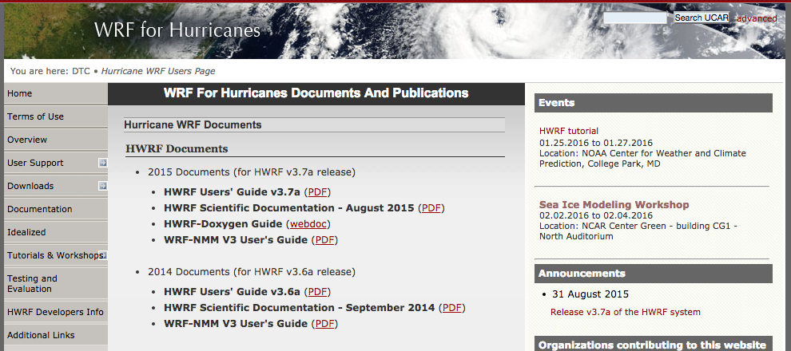
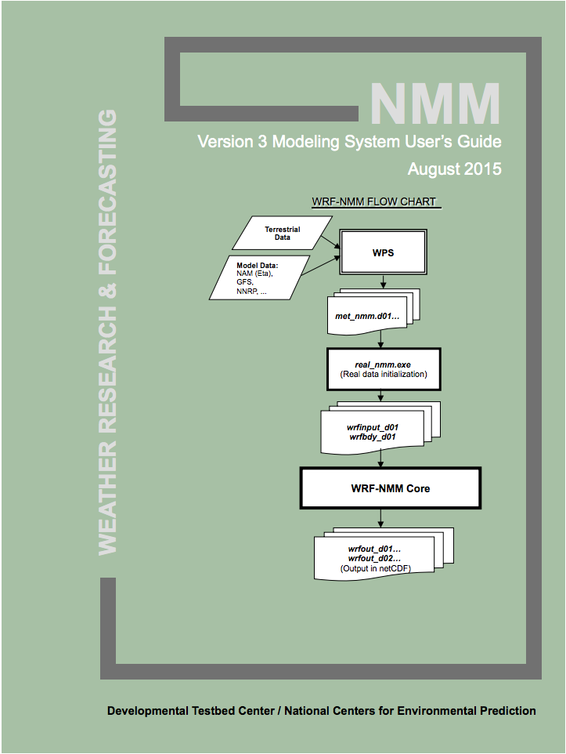
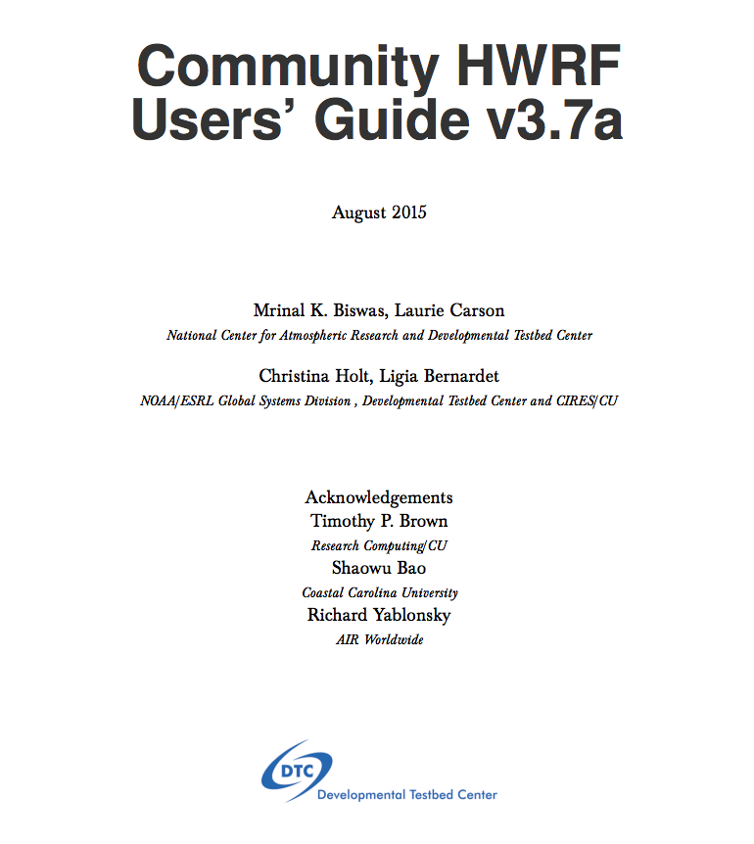

User support webpage
www.dtcenter.org/HurrWRF/users

Slide 5
Scientific Documentation
Technical information covering each HWRF component
Authorship includes developers and experts
Chapters covering:
HWRF introduction
HWRF Initialization
MPI POM-TC
Physics Packages in HWRF
Design of moving nest
Use of GFDL Vortex Tracker
The idealized HWRF framework
http://www.dtcenter.org/HurrWRF/users/docs/scientific_documents/HWRF_v3.7a_SD.pdf

Slide 6
HWRF v3.7a User’s Guide
Includes detailed instructions on running each component
Geared towards public release, so some aspects will be missing
Running with wrappers, no Rocoto information
Content:
Introduction & software installation
Running HWRF
HWRF preprocessing system
Vortex Relocation
DA
Merge
MPIPOM-TC
Forecast Model
Post processor
Forecast products
Idealized
http://www.dtcenter.org/HurrWRF/users/docs/users_guide/HWRF_v3.7a_UG.pdf

Slide 7
Doxygen Website

Slide 8
General Python help
Online (https://docs.python.org/release/2.6.6/)
Open python in a terminal and use help() function for particular function. An example to get information with a Python list:
$ python
$ help(list)
Must use Python v2.6.6.
Only version available on NOAA machines.
2.7 may be used in future because it's the long-term support release.
Version 3 is basically a different language.

Slide 9
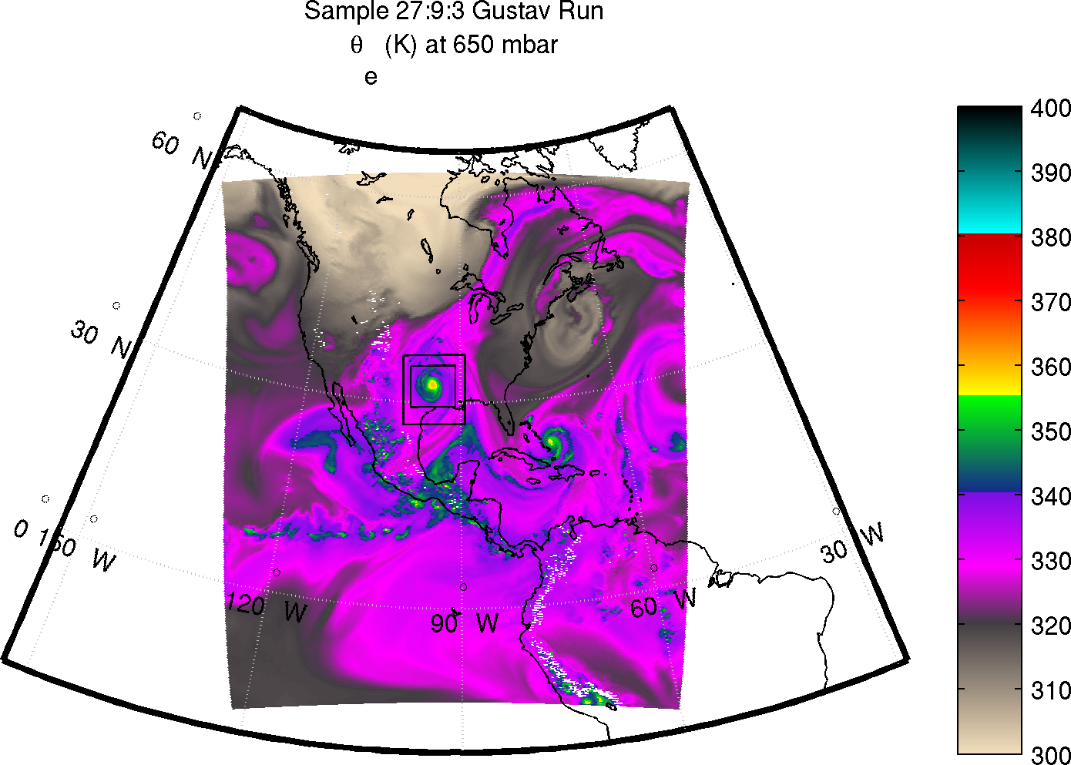
HWRF System Overview
Overview of the system design

Slide 10
HWRF System: Overview
7 layers of scripts that are responsible for preparing the environment and data for and running the ~80 HWRF executables of the end-to-end system
Most of these layers are written using an object-oriented (O-O) Python design
O-O design makes the system highly configurable and reduces the footprint of the system drastically

Slide 11
HWRF Directory Structure
hwrfrun/
doc/
parm/ ......................... *.conf
scripts/...................... exhwrf_*.py
sorc/
ush/.......................... hwrf_expt.py
.......................... produtil/
.......................... hwrf/
.......................... pom/
wrappers/
doc/
gfdl-vortextracker/
GSI/
hwrf-utilities/
ncep-coupler/
pomtc/
UPP/
WPSV3/
WRFV3/

Slide 12
HWRF System: Intercycle Layer
Handles interactions between several cycles
Complex dependencies
Files passed between them
Automation is not needed for a case study
Critical for a large retrospective study, and for real-time automation

Slide 13
HWRF System: Workflow Layer
Splits work into multiple batch jobs
Workflow managers handle dependencies, submission, failures, and resubmission of jobs
Human handles this process when using wrappers

Slide 14
HWRF System: Scripting Layer
Loads programs and libraries into computing environment
Ensures connection to file system on compute node
Passes file and executable locations to the next lower layer
Layer is optional – can be done manually by user

Slide 15
HWRF System: Experiment Layer
Describes the HWRF workflow
Creates the object structure that connects all the pieces
i.e. GSI should use input from the GDAS relocation output
Each object has a run() function to perform the actual task
Instantiates the hwrf_expt module

Slide 16
HWRF System: Implementation Layer
A set of Python classes and functions used by the Experiment layer to run HWRF
Each component has its own class and set of functions
Some classes perform utilities to support the system, such as predicting filenames and performing time/date arithmetic
Includes two packages
pom – Princeton Ocean Model initialization
hwrf – Implementation of most of the HWRF system

Slide 17
HWRF System: Portability Layer
Implements cross-platform methods of performing common tasks
MPI implementation
OpenMP
Serial programs
File operations
Batch system interaction
Manipulate resource limitations
Interact with database file

Slide 18
Workflow Object Structure
wrappers/post_wrapper
export TOTAL_TASKS=24
$EXhwrf/exhwrf_post.py
scripts/exhwrf_post.py:
import hwrf_expt
hwrf_expt.init_module()
hwrf_expt.post.run_post()
ush/hwrf_expt.py:
post=HWRFPost('/path/to/infile',
'/path/to/fixd', '/path/to/hwrf_post',
to_datetime('2015081818'))
ush/hwrf/post.py:
class HWRFPost
def run_post

Slide 19
Object-oriented Programming
An example for HWRF

Slide 20
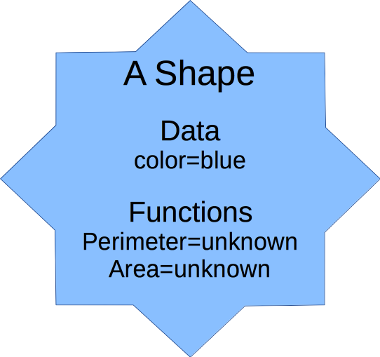
Object-oriented Python
class Shape:
def __init__(self,color):
self.__color=color
@property
def color(self):
return self.__color
@property
def perimeter(self):
return NotImplemented
@property
def area(self):
return NotImplemented

Slide 21
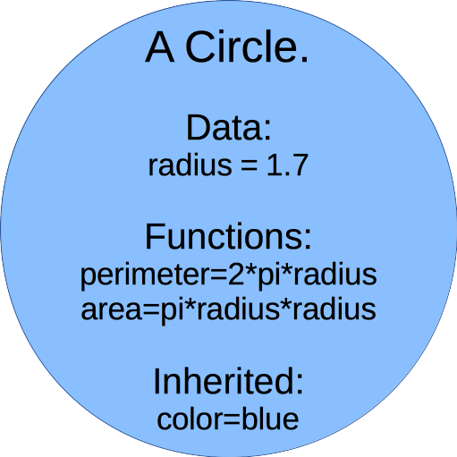
Object-oriented Python
class Circle(Shape):
def __init__(self,color,radius):
super(self,Circle).__init__(color)
self.__radius=radius
@property
def perimeter(self):
return math.pi*self.__radius*2
@property
def area(self):
return math.pi*self.__radius**2

Slide 22
An example for UnifiedPost
class UnifiedPost:
def __init__(self,infile,fixd,postexec,when):
(self.infile,self.fixd.self.postexec,self.when)=\
infile, fixd, postexec, when
def run_post(self):
self.link_fix()
self.make_itag()
make_symlink(self.infile,”INFILE”,
logger=self.log(),force=True)
cmd=mpirun(mpi(self.postexec)<”itag”)
checkrun(cmd,all_ranks=true,logger=self.log())
def link_fix(self):
fixes=[f for f in glob.glob(fixd+”/*”)]
make_symlinks_in(fixes,”.”,logger=self.log())

Slide 23
An example for UnifiedPost
class HWRFPost(UnifiedPost):
def make_itag (self):
with open(“itag”,”wt”) as f:
itagdata=self.when.strftime(
“INFILE\nnetcdf\n%Y-%m-%d_%H:%M:%S” “\nNMM NEST\n”)
f.write(itagdata)
class NEMSPost(UnifiedPost):
def make_itag (self):
with open(“itag”,”wt”) as f:
itagdata=self.when.strftime(
“INFILE\nnetcdf\n%Y-%m-%d_%H:%M:%S” “\nNEMS\n”)
f.write(itagdata)

Slide 24
Configuring HWRF
Conf files
hwrf_expt.py

Slide 25
Configuring HWRF Overview

Slide 26
Unix .conf Files
Simple format
# This is a comment
[section]
key=value ; This is also a comment
key2=value2
Doxygen format
## Short description of section
# # Long description of section
# @note Doxygen+markdown syntax
[section]
key=value ;; short description of key
## Short description of key2
#
# long description of key2
key2=value2

Slide 27
Unix Conf Files
String substitution
String substitution with formatting
Substitute from other sections
[myprog]
basedir = /some/path
exename = myexe.x
exepath = {basedir}/exec/{exename}
exepath = /some/path/exec/myexe.x
[myprog]
gridnum = 5
exename = myexe_{gridnum:02d}.x
exepath = {basedir}/exec/{exename}
exename = myexe_5.x
[grid]
num = 5
[myprog]
exename = myexe_{grid/num:02d}.x
exepath = {basedir}/exec/{exename}
exename = myexe_05.x

Slide 28
Config Processing
Python ConfigParser.ConfigParser parses the *.conf files in order
Puts result in an in-memory hwrf.launcher.HWRFLauncher object

Slide 29
storm1.conf
exhwrf_launch writes storm1.conf
storm1.conf contains all the processed config data for later jobs to read
No other conf file is processed
Later jobs read storm1.conf using hwrf.launcher.load
hwrf.launcher.HWRFLauncher contains many convenience functions for using the conf info

Slide 30
HWRF Python Tasks
HWRFLauncher & HWRFConfig
Classes that access conf data
getstr(section, key, default)
Returns default value if none specified in storm1.conf
getint, getfloat, getbool, etc. (see docs for full list)
HWRFTask is an instance of each of the tasks to be completed
Examples include GeogridTask,WRFAtmos, etc.
Has a database task name, a conf section, and an HWRFConfig
hwrf.namelist.NamelistInserter reformats storm1.conf information into Fortran namelist files needed for various components

Slide 31
Data Communication
Database introduction
Passing around information

Slide 32
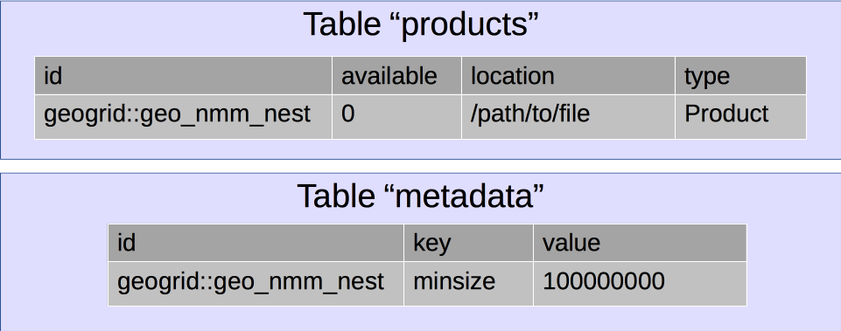
HWRF Database
HWRF needs to know the status/availability of files millions of times per cycle
When a file becomes available, a Python script puts its location, availability, and other metadata into an SQLite3 database

Slide 33
HWRF Database & produtil
The produtil package contains all the HWRF utilities to write to and query the SQLite3 database
produtil includes methods to check, deliver, and “undeliver” files
prod.check – Check for file of specified minimum size and age
Returns status as RUNNING, COMPLETED, FAILED
prod.undeliver – Remove file from working area
prod.deliver – Deliver file to specified location
You can query the database on your own like any other SQLite3 database
For a list of the input/output needed for HWRF, see hwrf.fcsttask.WRFTaskBase

Slide 34
Logging

Slide 35
stderr and stdout
Located in the $WORKhwrf directory
stdout files contain all the logging (info, error, critical level) messages from the Python scripts
stderr files contain all the error and critical messages, plus the submission information for the job (PROLOGUE, EPILOGUE)
Can be separated into hwrf_*.out and hwrf_*.err, or joined into one stream. Depends on your job submission script.
At least one set/file for each task.
Multiple processor jobs have multiple sets of logs
post, products, tracker, etc.

Slide 36
Writing to the standard out
Adding log messages can be done from the ush scripts with a few simple commands
logger=self.log()
logger.info(‘This is the value of some_variable: %s’ %(some_variable))
logger.warning(‘This is a warning!’)
logger.error(‘This is an error’)
logger.critical(‘This is really bad!’)
Result:
01/08 04:34:45.706 hwrf.gfsinit (relocate.py:353) INFO: This is the value of some_variable: 270.0
01/08 04:34:45.902 hwrf.gfsinit (relocate.py:354) WARNING: This is a warning!

Slide 37
Python Exception Stacks
Several lines you get when you fail.
Traceback (most recent call last):
File "/pan2/projects/dtc-hurr/dtc/HWRF_training//scripts/exhwrf_gsi.py", line 60, in <module>
main()
File "/pan2/projects/dtc-hurr/dtc/HWRF_training//scripts/exhwrf_gsi.py", line 53, in main
hwrf_expt.gsi_d02.run()
File "/pan2/projects/dtc-hurr/dtc/HWRF_training/ush/hwrf/gsi.py", line 982, in run
self.grab_enkf_input()
File "/pan2/projects/dtc-hurr/dtc/HWRF_training/ush/hwrf/gsi.py", line 285, in grab_enkf_input
self.grab_gfs_enkf()
File "/pan2/projects/dtc-hurr/dtc/HWRF_training/ush/hwrf/gsi.py", line 607, in grab_gfs_enkf
%(there,))
GSIInputError: required input file is empty or non-existent: /pan2/projects/dtc-hurr/dtc/HWRF_training/pytmp/HWRF_training/2015082000/17W/hwrfdata/enkf.2015081918/sfg_2015081918_fhr06s_mem001

Slide 38
Output from components
Many components have their own log files
For example:
WRF: rsl.out.* and rsl.err.*
WPS: metgrid.log.*, geogrid.log.*, ungrib.log
GSI: stdout
Coupler: cpl.out

Slide 39
Questions?

